Slide 1
Business Statistics:
A First Course
(3rd Edition)
Chapter 8
Hypothesis Tests for Numerical Data
from Two or More Samples

Slide 2
Chapter Topics
Comparing Two Independent Samples
  Independent samples Z Test for the difference in two means
  Pooled-variance t Test for the difference in two means
F Test for the Difference in Two Variances
Comparing Two Related Samples
  Paired-sample Z test for the mean difference
  Paired-sample t test for the mean difference

Slide 3
Chapter Topics
(continued)
The Completely Randomized Design:
One-Way Analysis of Variance
  ANOVA Assumptions
  F Test for Difference in More than Two Means
  The Tukey-Kramer Procedure

Slide 4
Comparing Two Independent Samples
Different Data Sources
  Unrelated
  Independent
    Sample selected from one population has no effect or bearing on the sample selected from the other population
Use the Difference between 2 Sample Means
Use Z Test or Pooled-Variance t Test

Slide 5
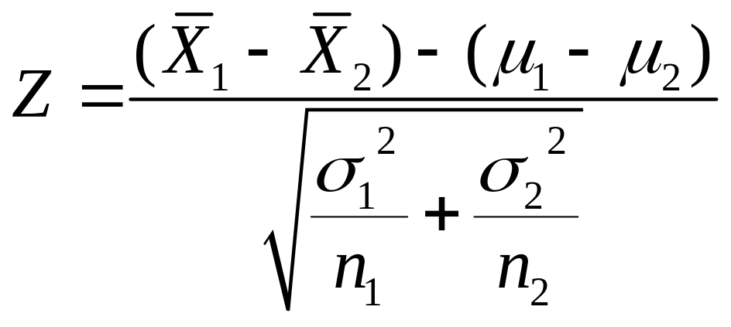
Independent Sample Z Test (Variances Known)
Assumptions
  Samples are randomly and independently drawn from normal distributions
  Population variances are known
Test Statistic

Slide 6
Independent Sample (Two Sample) Z Test in EXCEL
Independent Sample Z Test with Variances Known
  Tools | Data Analysis | z-test: Two Sample for Means

Slide 7
Pooled-Variance t Test (Variances Unknown)
Assumptions
  Both populations are normally distributed
  Samples are randomly and independently drawn
  Population variances are unknown but assumed equal
  If both populations are not normal, need large sample sizes

Slide 8
Developing the Pooled-Variance t Test
Setting Up the Hypotheses
H₀: μ ₁ = μ ₂ H₁: μ ₁ ≠ μ ₂
H₀: μ ₁ -μ ₂ = 0 H₁: μ ₁ - μ ₂ ≠ 0
Two Tail
OR
H₀: μ ₁ ≤ μ ₂ H₁: μ ₁ > μ ₂
H₀: μ ₁ - μ ₂ ≤ 0 H₁: μ ₁ - μ ₂ > 0
Right Tail
OR
H₀: μ ₁ ≥ μ ₂
H₀: μ ₁ - μ ₂ ≥ 0 H₁: μ ₁ - μ ₂ < 0
Left Tail
OR
H₁: μ ₁ < μ ₂

Slide 9
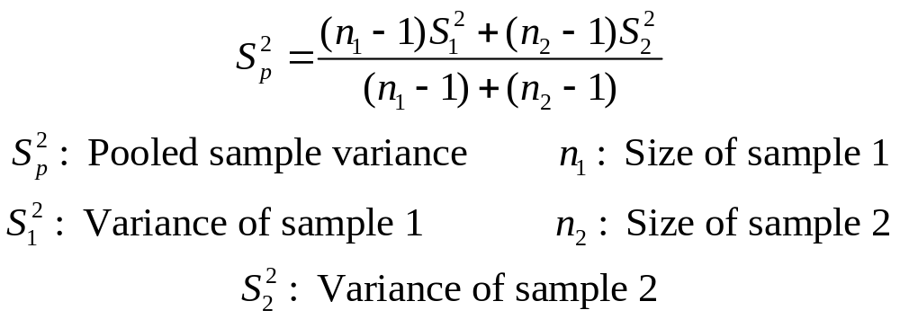
Developing the Pooled-Variance t Test
(continued)
Calculate the Pooled Sample Variance as an Estimate of the Common Population Variance

Slide 10
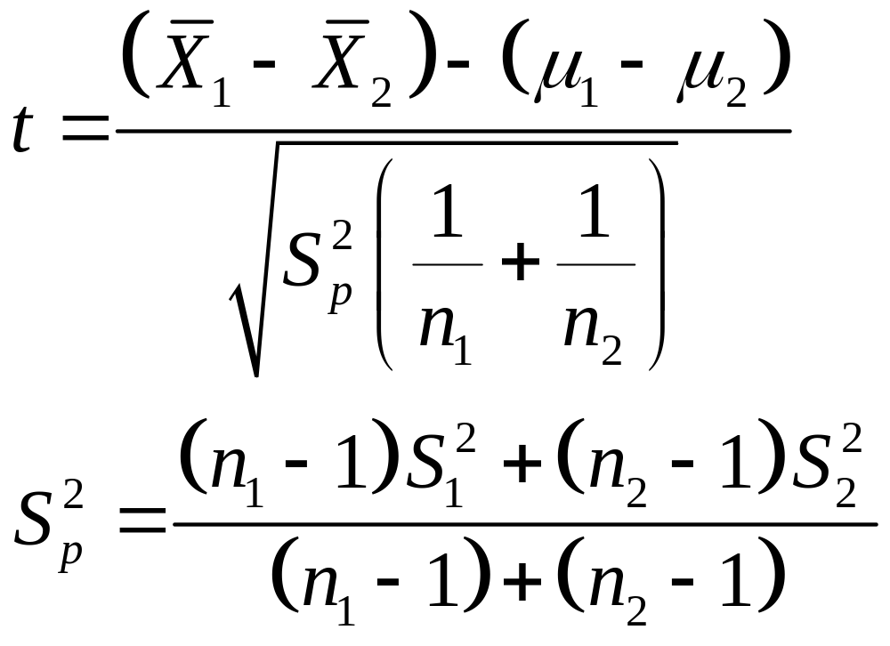
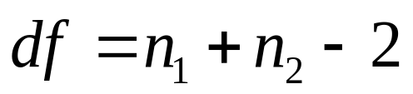
Developing the Pooled-Variance t Test
(continued)
Compute the Sample Statistic
Hypothesized difference

Slide 11
Pooled-Variance t Test: Example
You’re a financial analyst for Charles Schwab. Is there a difference in dividend yield between stocks listed on the NYSE & NASDAQ? You collect the following data:
NYSE NASDAQ
Number 21 25
Sample Mean 3.27 2.53
Sample Std Dev 1.30 1.16
Assuming equal variances, is
there a difference in average
yield (α = 0.05)?
© 1984-1994 T/Maker Co.

Slide 12
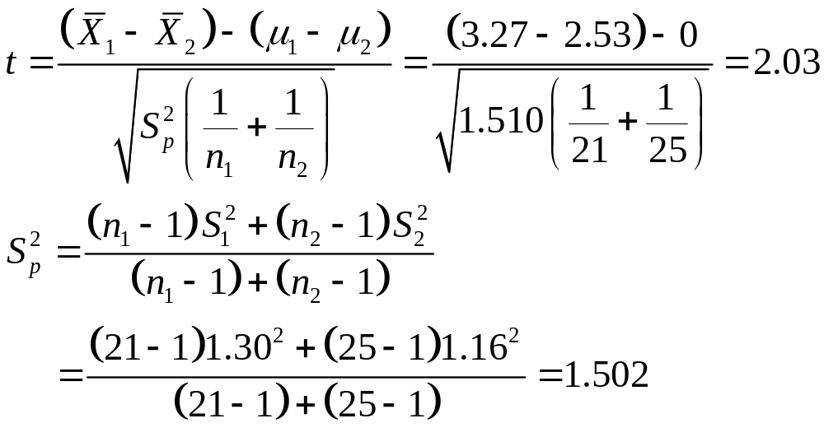
Calculating the Test Statistic

Slide 13
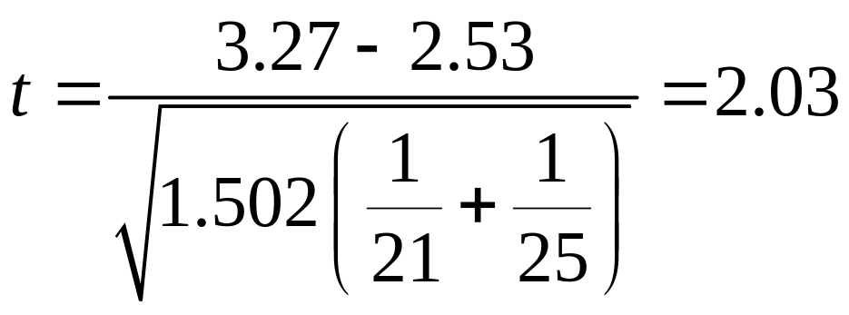
Solution
H₀: μ₁ - μ₂ = 0 i.e. (μ₁ = μ₂)
H₁: μ₁ - μ₂ ≠ 0 i.e. (μ₁ ≠ μ₂)
α = 0.05
df = 21 + 25 - 2 = 44
Critical Value(s):
Test Statistic:
Decision:
Conclusion:
Reject H
Reject H
Reject at α = 0.05
0
0
.025
.025
There is evidence of a difference in means.
-2.0154
0
2.0154
t
2.03

Slide 14
p -Value Solution
(p-Value is between .02 and .05) < (α = 0.05). Reject.
p-Value
2
is between .01 and .025
Reject
Reject
α
2
=.025
0
Z
-2.0154
2.0154
2.03
Test Statistic 2.03 is in the Reject Region

Slide 15
Pooled-Variance t Test in
PHStat and Excel
If the Raw Data are Available
  Tools | Data Analysis | t-Test: Two Sample Assuming Equal Variances
If only Summary Statistics are Available
  PHStat | Two-Sample Tests | t Test for Differences in Two Means...

Slide 16

Solution in EXCEL
Excel Workbook that Performs the Pooled-Variance t Test

Slide 17
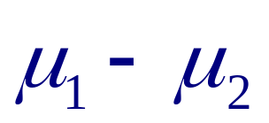
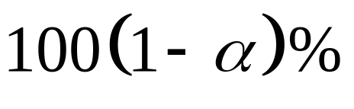
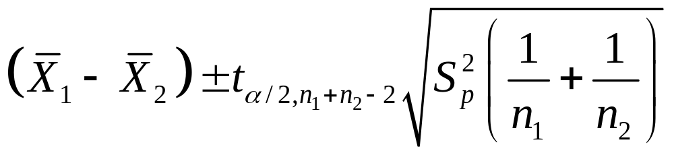
Confidence Interval Estimate for of Two Independent Groups
Assumptions
  Both populations are normally distributed
  Samples are randomly and independently drawn
  Population variances are unknown but assumed equal
  If both populations are not normal, need large sample sizes
Confidence Interval Estimate:

Slide 18
Example
You’re a financial analyst for Charles Schwab. You collect the following data:
NYSE NASDAQ
Number 21 25
Sample Mean 3.27 2.53
Sample Std Dev 1.30 1.16
You want to construct a 95% confidence interval for the difference in population average yields of the stocks listed on NYSE and NASDAQ.
© 1984-1994 T/Maker Co.

Slide 19
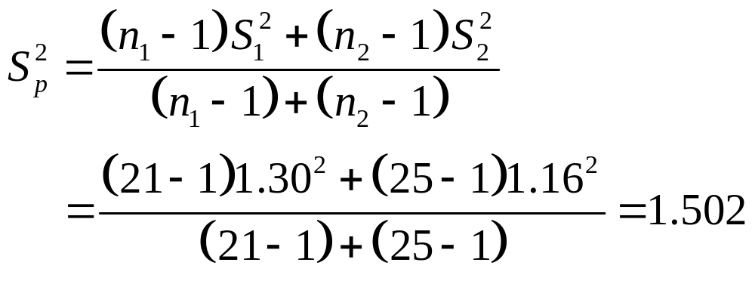
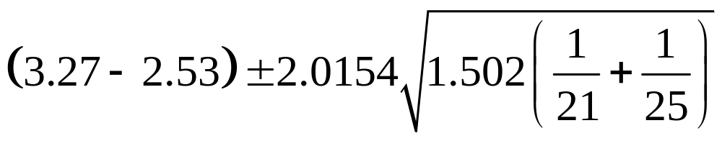
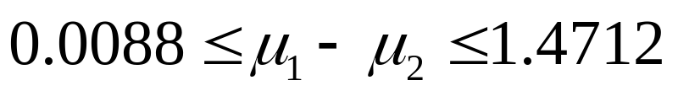
Example: Solution

Slide 20

Solution in Excel
An Excel Spreadsheet with the Solution:

Slide 21
F Test for Difference in Two Population Variances
Test for the Difference in 2 Independent Populations
Parametric Test Procedure
Assumptions
  Both populations are normally distributed
    Test is not robust to this violation
  Samples are randomly and independently drawn

Slide 22
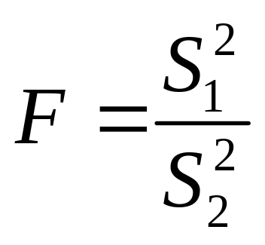
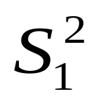

The F Test Statistic
= Variance of Sample 1
n₁ - 1 = degrees of freedom
= Variance of Sample 2
n₂ - 1 = degrees of freedom
0
F

Slide 23
Developing the F Test
Hypotheses
  H₀: σ₁² = σ₂²
  H₁: σ₁² ≠ σ₂²
Test Statistic
  F = S₁² /S₂²
  Two Sets of Degrees of Freedom
    df₁ = n₁ - 1; df₂ = n₂ - 1
  Critical Values: F_{L( )} and F_{U( )}
  F_{L} = 1/F_{U}* (*degrees of freedom switched)
Reject H₀
Reject H₀
Do Not
Reject
α/2
α/2
0
F_{L}
F_{U}
F
n₁ -1, n₂ -1
n₁ -1 , n₂ -1

Slide 24
F Test: An Example
Assume you are a financial analyst for Charles Schwab. You want to compare dividend yields between stocks listed on the NYSE & NASDAQ. You collect the following data:
NYSE NASDAQ
Number 21 25
Mean 3.27 2.53
Std Dev 1.30 1.16
Is there a difference in the variances between the NYSE & NASDAQ at the α = 0.05 level?
© 1984-1994 T/Maker Co.

Slide 25
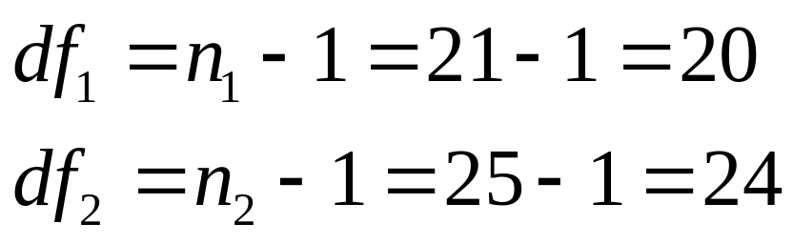
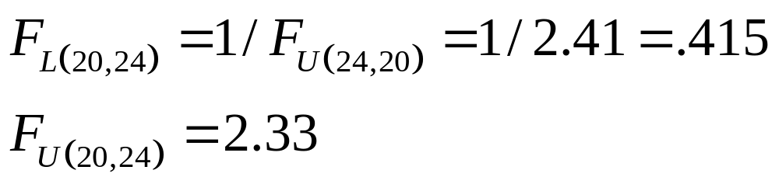
F Test: Example Solution
Finding the Critical Values for α = .05

Slide 26
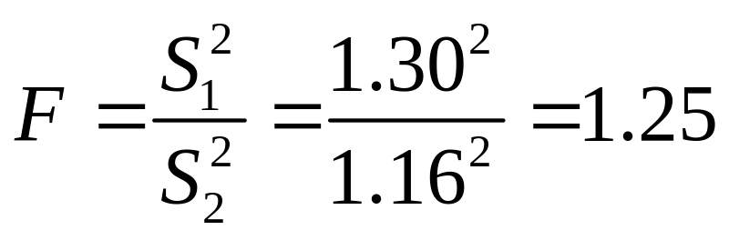
F Test: Example Solution
Test Statistic:
Decision:
Conclusion:
H₀: σ₁² = σ₂²
H₁: σ₁² ≠ σ₂²
α = .05
df₁ = 20 df₂ = 24
Critical Value(s):
Reject
Reject
Do not reject at α = 0.05
.025
.025
There is insufficient evidence to prove a difference in variances.
0
0.415
2.33
F
1.25

Slide 27
F Test in PHStat
PHStat | Two-Sample Tests | F Test for Differences in Two Variances
Example in Excel Spreadsheet

Slide 28
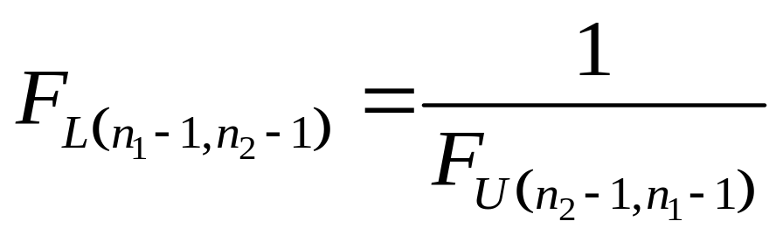
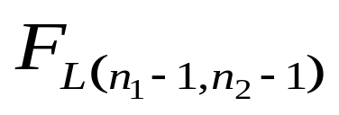
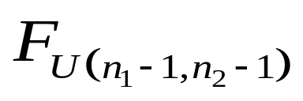
F Test: One-Tail
H₀: σ₁² ≥ σ₂²
H₀: σ₁² ≤ σ₂²
or
  H₁: σ₁² < σ₂²
  H₁: σ₁² > σ₂²
α = .05
Degrees of freedom switched
Reject
Reject
α = .05
α = .05
0
F
0
F

Slide 29
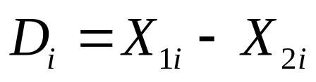
Comparing Two Related Samples
Test the Means of Two Related Samples
  Paired or matched
  Repeated measures (before and after)
  Use difference between pairs
Eliminates Variation between Subjects

Slide 30
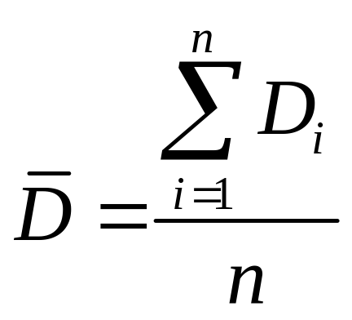
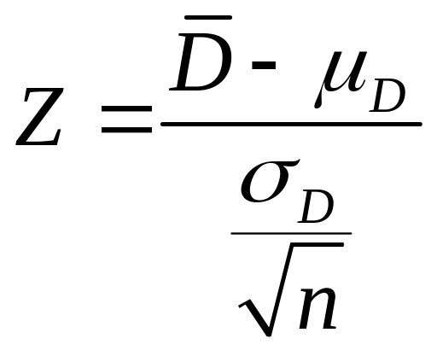
Z Test for Mean Difference (Variance Known)
Assumptions
  Both populations are normally distributed
  Observations are paired or matched
  Variance Known
Test Statistic

Slide 31

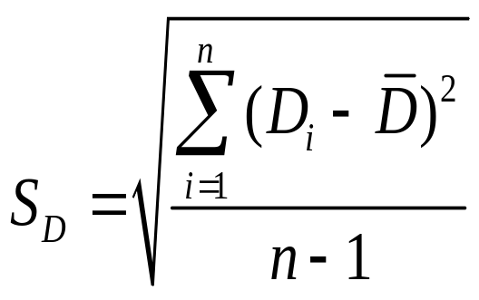
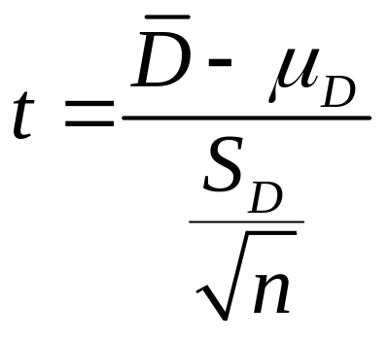
t Test for Mean Difference (Variance Unknown)
Assumptions
  Both populations are normally distributed
  Observations are matched or paired
  Variance unknown
  If population not normal, need large samples
Test Statistic

Slide 32

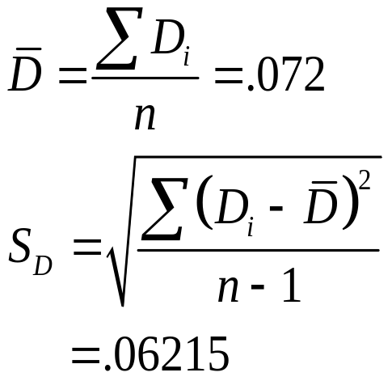
Paired-Sample t Test: Example
Assume you work in the finance department. Is the new financial package faster (α=0.05 level)? You collect the following processing times:
Existing System (1) New Software (2) Difference D_{i}
9.98 Seconds 9.88 Seconds .10
9.88 9.86 .02
9.84 9.75 .09
9.99 9.80 .19
9.94 9.87 .07
9.84 9.84 .00
9.86 9.87 - .01
10.12 9.98 .14
9.90 9.83 .07
9.91 9.86 .05

Slide 33

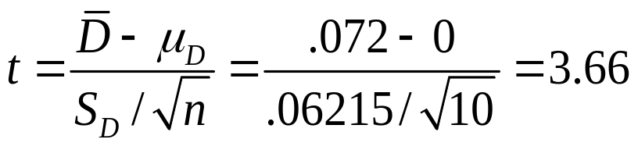
Paired-Sample t Test: Example Solution
Is the new financial package faster (0.05 level)?
H₀: μ_{D} ≤ 0
H₁: μ_{D} > 0
Reject
α =.05
D =
.072
α =.05
Critical Value=1.8331 df = n - 1 = 9
1.8331
3.66
Decision: Reject H₀
t Stat. in the rejection zone.
Test Statistic
Conclusion: The new software package is faster.

Slide 34

Paired-Sample t Test in
EXCEL
Tools | Data Analysis… | t-test: Paired Two Sample for Means
Example in Excel Spreadsheet

Slide 35
General Experimental Setting
Investigator Controls One or More Independent Variables
  Called treatment variables or factors
  Each treatment factor contains two or more groups (or levels)
Observe Effects on Dependent Variable
  Response to groups (or levels) of independent variable
Experimental Design: The Plan Used to Test Hypothesis

Slide 36
Completely Randomized Design
Experimental Units (Subjects) are Assigned Randomly to Groups
  Subjects are assumed homogeneous
Only One Factor or Independent Variable
  With 2 or more groups (or levels)
Analyzed by One-way Analysis of Variance (ANOVA)

Slide 37



Randomized Design Example
 | Factor (Training Method)
Factor Levels (Groups)
Randomly Assigned Units
Dependent Variable (Response) | 21 hrs | 17 hrs | 31 hrs
 | 27 hrs | 25 hrs | 28 hrs
 | 29 hrs | 20 hrs | 22 hrs
😐 😐 😐
😐 😐 😐
😐 😐 😐

Slide 38
One-way Analysis of Variance
F Test
Evaluate the Difference among the Mean Responses of 2 or More (c ) Populations
  E.g. Several types of tires, oven temperature settings
Assumptions
  Samples are randomly and independently drawn
    This condition must be met
  Populations are normally distributed
    F Test is robust to moderate departure from normality
  Populations have equal variances
    Less sensitive to this requirement when samples are of equal size from each population

Slide 39
Why ANOVA?
Could Compare the Means One by One using Z or t Tests for Difference of Means
Each Z or t Test Contains Type I Error
The Total Type I Error with k Pairs of Means is 1- (1 - α) ^{k}
  E.g. If there are 5 means and use α = .05
    Must perform 10 comparisons
    Type I Error is 1 – (.95) ¹⁰ = .40
    40% of the time you will reject the null hypothesis of equal means in favor of the alternative when the null is true!

Slide 40
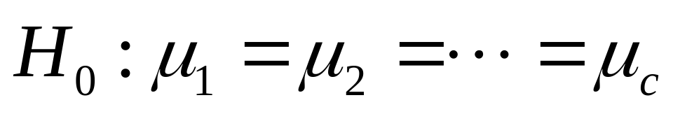
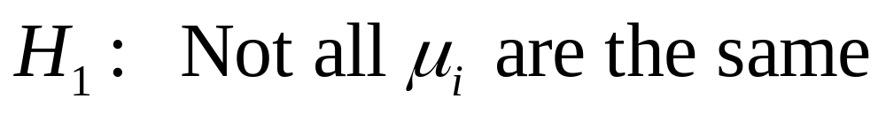
Hypotheses of One-Way ANOVA
  All population means are equal
  No treatment effect (no variation in means among groups)
  At least one population mean is different (others may be the same!)
  There is a treatment effect
  Does not mean that all population means are different

Slide 41
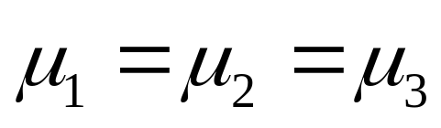
One-way ANOVA
(No Treatment Effect)
The Null Hypothesis is True

Slide 42
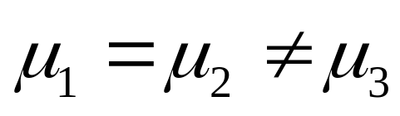
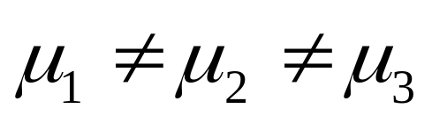
One-way ANOVA
(Treatment Effect Present)
The Null Hypothesis is NOT True

Slide 43
One-way ANOVA
(Partition of Total Variation)
Total Variation SST
Variation Due to Treatment SSA
+
Variation Due to Random Sampling SSW
=
Commonly referred to as:
Among Group Variation
Sum of Squares Among
Sum of Squares Between
Sum of Squares Model
Sum of Squares Explained
Sum of Squares Treatment
Commonly referred to as:
Within Group Variation
Sum of Squares Within
Sum of Squares Error
Sum of Squares Unexplained

Slide 44
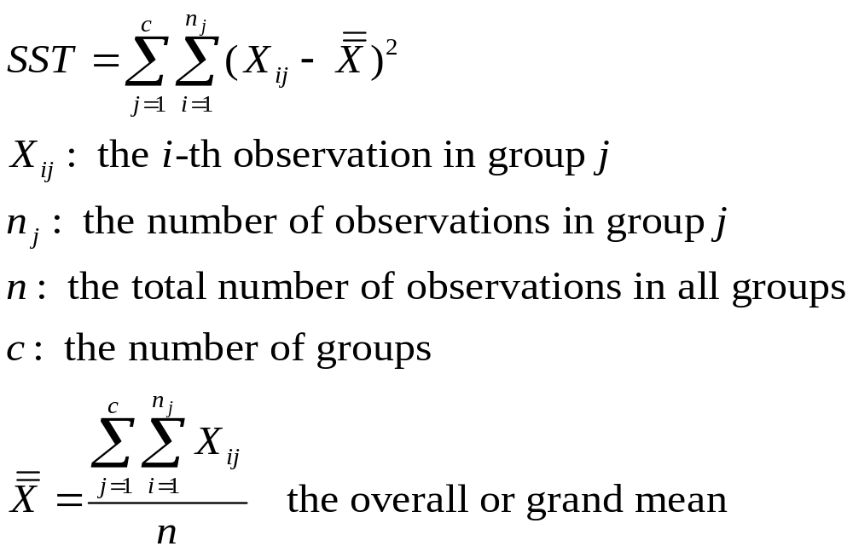
Total Variation

Slide 45
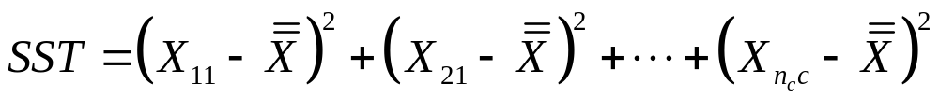
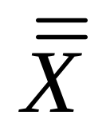
Total Variation
(continued)
Response, X
Group 1
Group 2
Group 3

Slide 46
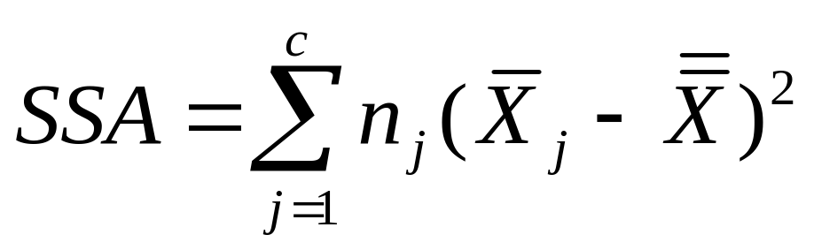
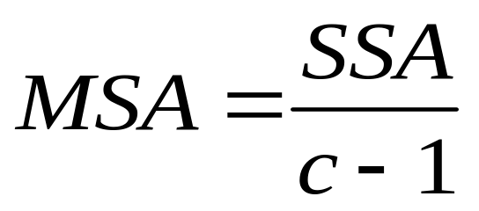
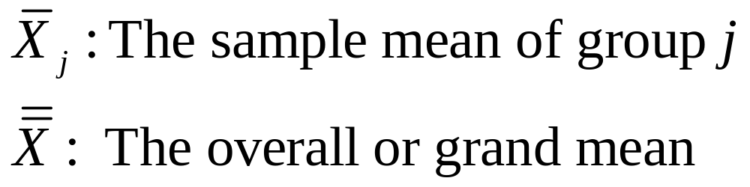


Among-Group Variation
Variation Due to Differences Among Groups.

Slide 47
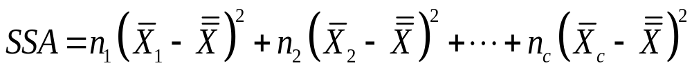
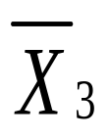
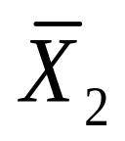
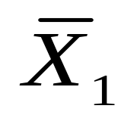
Among-Group Variation
(continued)
Response, X
Group 1
Group 2
Group 3

Slide 48
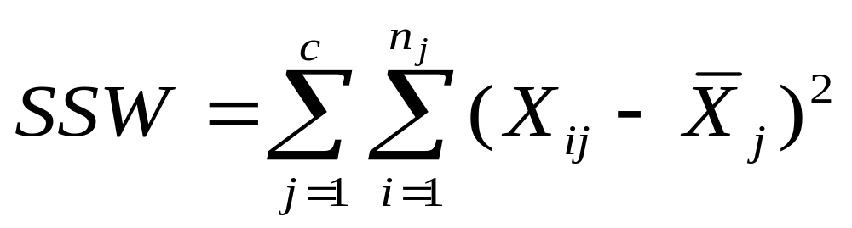
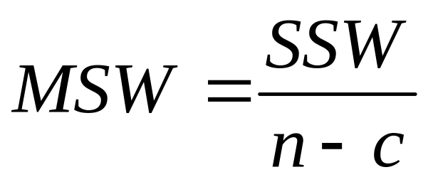
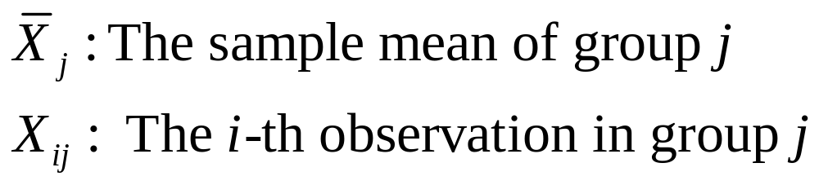
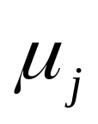
Within-Group Variation
Summing the variation within each group and then adding over all groups.

Slide 49
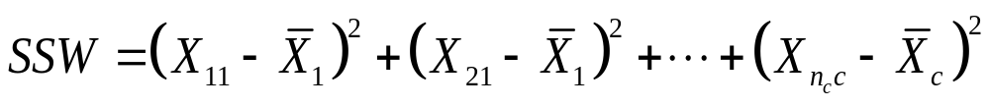
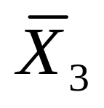
Within-Group Variation
(continued)
Response, X
Group 1
Group 2
Group 3

Slide 50
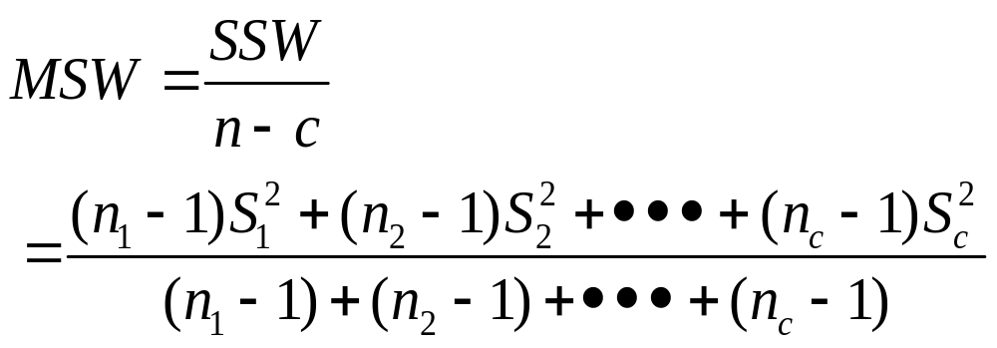
Within-Group Variation
(continued)
For c = 2, this is the pooled-variance in the t-Test.
If more than 2 groups, use F Test.
For 2 groups, use t-Test. F Test more limited.

Slide 51
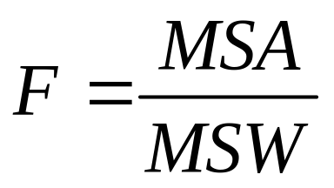


One-way ANOVA
F Test Statistic
Test Statistic
    MSA is mean squares among
    MSW is mean squares within
Degrees of Freedom

Slide 52
One-way ANOVA
Summary Table
Source of Variation | Degrees of Freedom | Sum of Squares | Mean Squares (Variance) | F Statistic
Among (Factor) | c – 1 | SSA | MSA = SSA/(c – 1 ) | MSA/MSW
Within (Error) | n – c | SSW | MSW = SSW/(n – c )
Total | n – 1 | SST = SSA + SSW

Slide 53
Features of One-way ANOVA
F Statistic
The F Statistic is the Ratio of the Among Estimate of Variance and the Within Estimate of Variance
  The ratio must always be positive
  df₁ = c -1 will typically be small
  df₂ = n - c will typically be large
The Ratio Should be Close to 1 if the Null is True

Slide 54
Features of One-way ANOVA
F Statistic
(continued)
If the Null Hypothesis is False
  The numerator should be greater than the denominator
  The ratio should be larger than 1

Slide 55
One-way ANOVA F Test
Example
As production manager, you want to see if 3 filling machines have different mean filling times. You assign 15 similarly trained and experienced workers, 5 per machine, to the machines. At the .05 significance level, is there a difference in mean filling times?
Machine1 Machine2 Machine3
25.40 23.40 20.00
26.31 21.80 22.20
24.10 23.50 19.75
23.74 22.75 20.60
25.10 21.60 20.40

Slide 56

One-way ANOVA Example: Scatter Diagram
Machine1 Machine2 Machine3
25.40 23.40 20.00
26.31 21.80 22.20
24.10 23.50 19.75
23.74 22.75 20.60
25.10 21.60 20.40
Time in Seconds
27
26
25
24
23
22
21
20
19
•
•
•
•
•
•
•
•
•
•
•
•
•
•
•

Slide 57



One-way ANOVA Example Computations
Machine1 Machine2 Machine3
25.40 23.40 20.00
26.31 21.80 22.20
24.10 23.50 19.75
23.74 22.75 20.60
25.10 21.60 20.40

Slide 58
Summary Table
Source of Variation | Degrees of Freedom | Sum of Squares | Mean Squares (Variance) | F Statistic
Among (Factor) | 3-1=2 | 47.1640 | 23.5820 | MSA/MSW =25.60
Within (Error) | 15-3=12 | 11.0532 | .9211
Total | 15-1=14 | 58.2172

Slide 59
One-way ANOVA Example Solution
Test Statistic:
Decision:
Conclusion:
H₀: μ₁ = μ₂ = μ₃
H₁: Not All Equal
α = .05
df₁= 2 df₂ = 12
Critical Value(s):
MSA
23
5820
.
F
=
=
=
25
.
6
MSW
.
9211
Reject at α = 0.05
α = 0.05
There is evidence that at least one μ _{i} differs from the rest.
0
3.89
F

Slide 60

Solution In EXCEL
Use Tools | Data Analysis | ANOVA: Single Factor
EXCEL Worksheet that Performs the One-way ANOVA of the example

Slide 61
The Tukey-Kramer Procedure
Tells which Population Means are Significantly Different
  e.g., μ₁ = μ₂ ≠ μ₃
  2 groups whose means
  may be significantly
  different
Post Hoc (a posteriori) Procedure
  Done after rejection of equal means in ANOVA
Pairwise Comparisons
  Compare absolute mean differences with critical range
f(X)
μ
=
μ
μ
X
1
2
3

Slide 62


The Tukey-Kramer Procedure: Example
1. Compute absolute mean differences:
Machine1 Machine2 Machine3
25.40 23.40 20.00
26.31 21.80 22.20
24.10 23.50 19.75
23.74 22.75 20.60
25.10 21.60 20.40
2. Compute Critical Range:
3. All of the absolute mean differences are greater than the critical range. There is a significance difference between each pair of means at the 5% level of significance.

Slide 63
Solution in PHStat
Use PHStat | c-Sample Tests | Tukey-Kramer Procedure …
EXCEL Worksheet that Performs the Tukey-Kramer Procedure for the Previous example

Slide 64
Chapter Summary
Compared Two Independent Samples
  Performed Z test for the differences in two means
  Performed t test for the differences in two means
Addressed F Test for Difference in two Variances
Compared Two Related Samples
  Performed paired sample Z tests for the mean difference
  Performed paired sample t tests for the mean difference

Slide 65
Chapter Summary
(continued)
Described The Completely Randomized Design: One-way Analysis of Variance
  ANOVA Assumptions
  F Test for Difference in c Means
  The Tukey-Kramer Procedure

